Slide 1
Assembly Language
Class Lecture

Slide 2
Flow Control Instructions

Slide 3
Transfer of Control
Flow control instructions are used to control the flow of a program.
Flow control instructions can be of two types: unconditional and conditional.
The JMP instruction is the only unconditional flow control instruction.

Slide 4
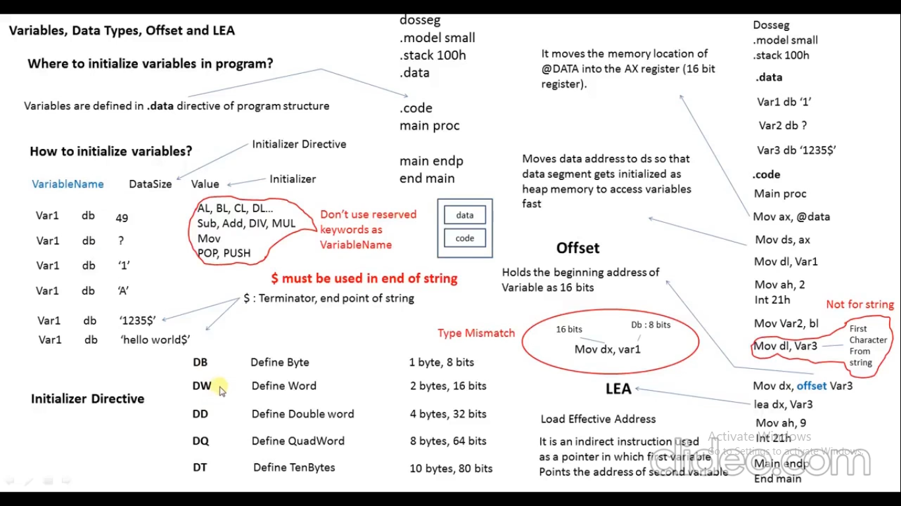

Slide 5
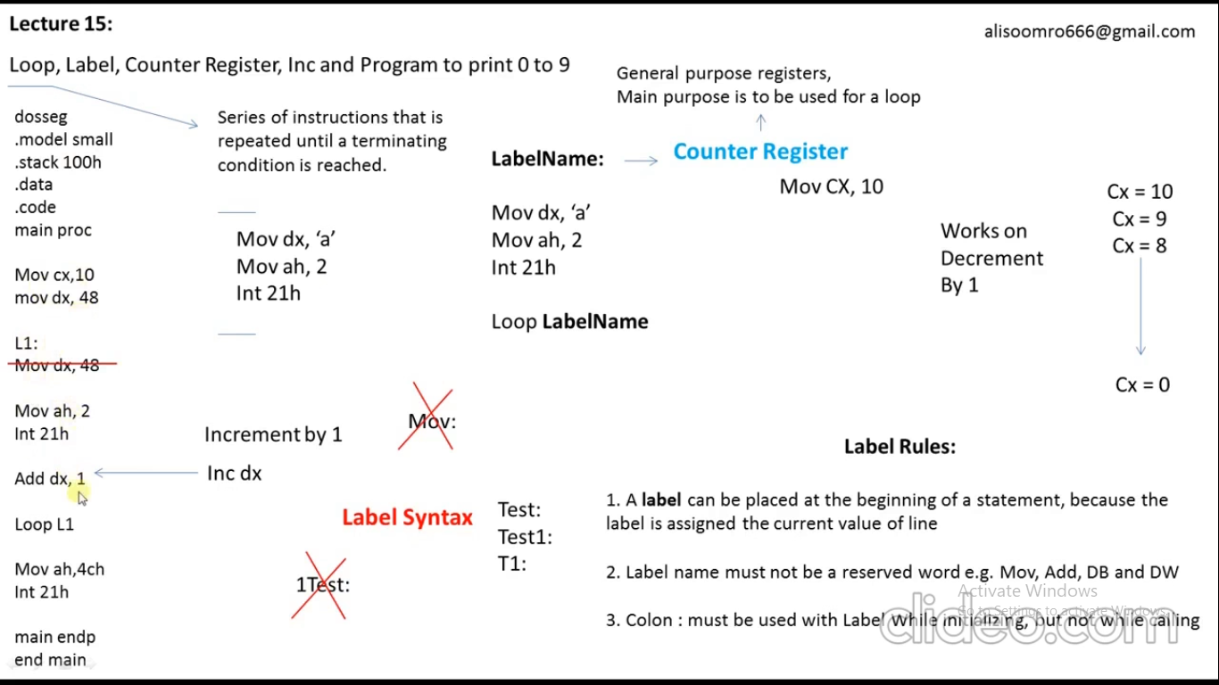

Slide 6
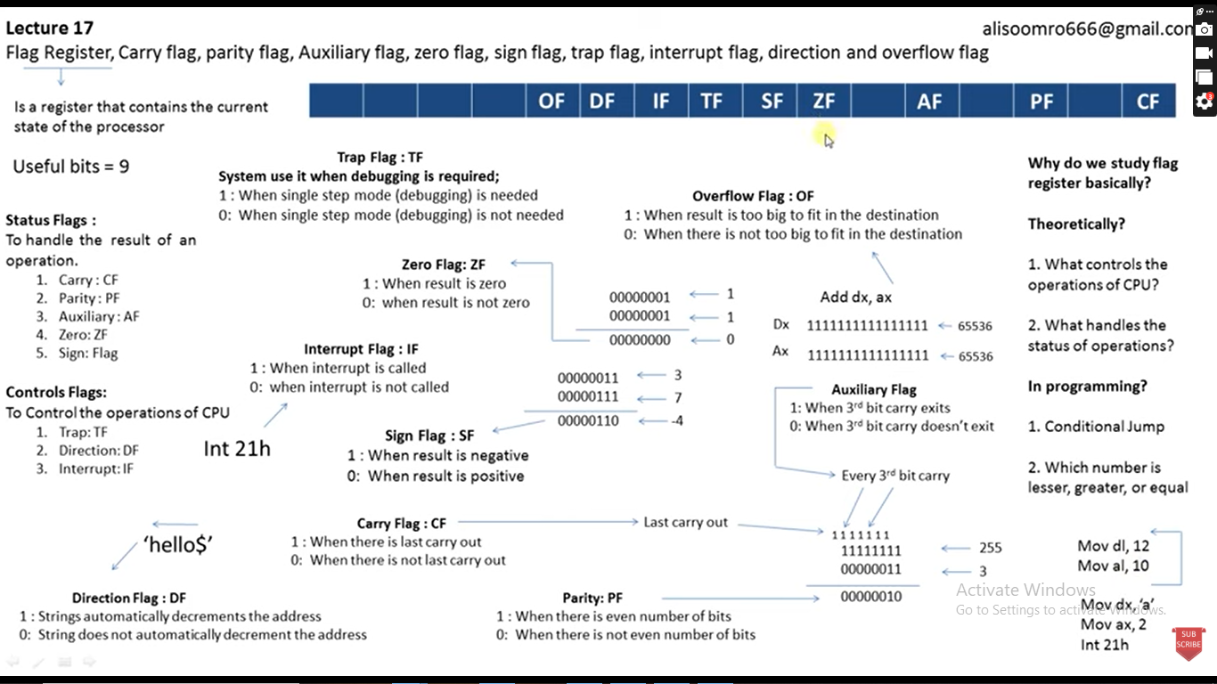

Slide 7
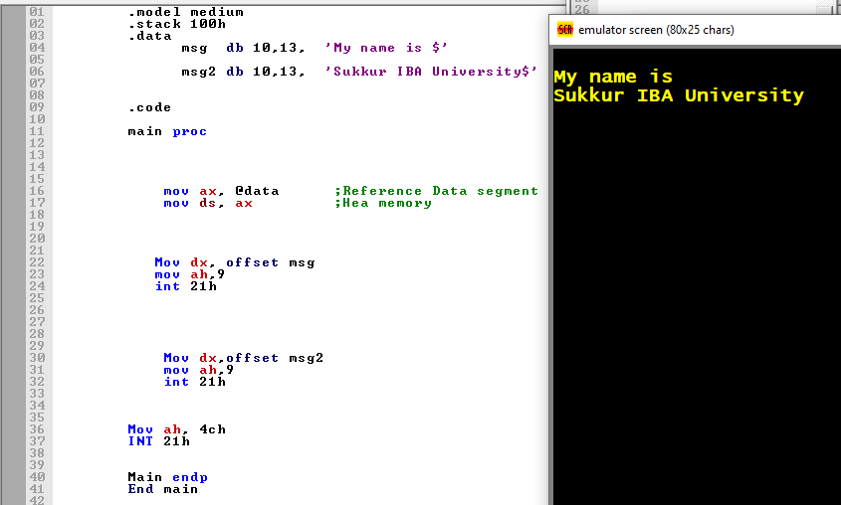

Slide 8
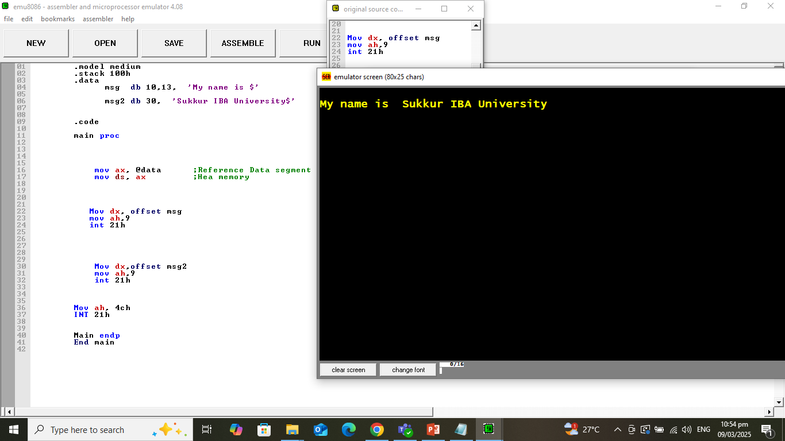

Slide 9
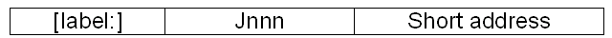
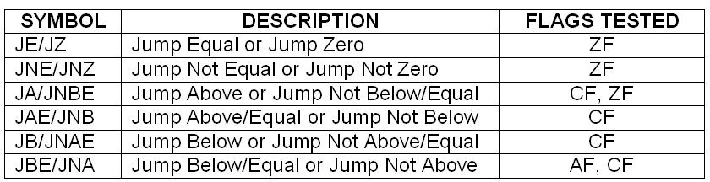
Conditional JUMP Instructions
Format for conditional jump (Jnnn) is:
There are varieties of conditional jump instructions that transfer control depending on settings in the flags register: ZF, CF, OF, AF and SF.
Table below shows some example of conditional jump that are used for unsigned data.

Slide 10
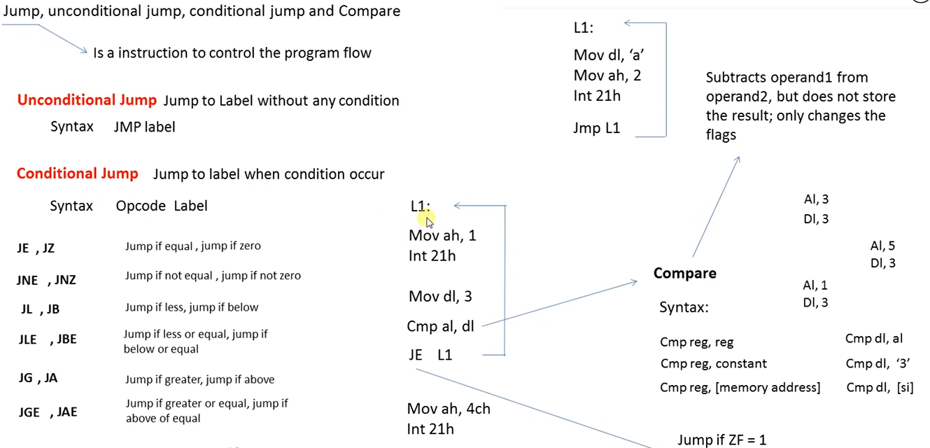

Slide 11
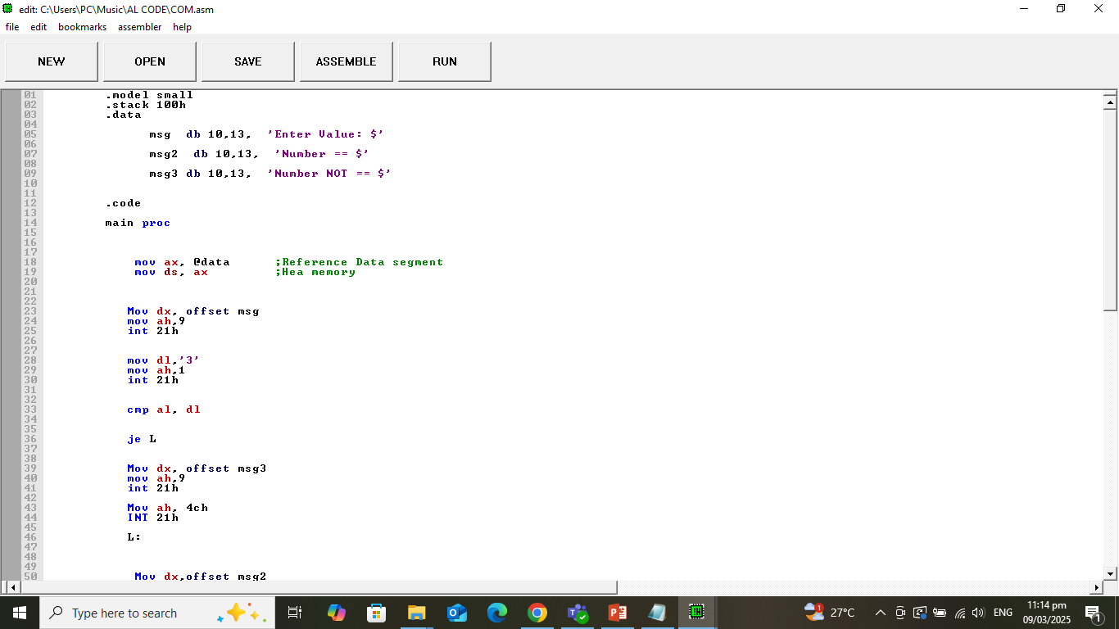
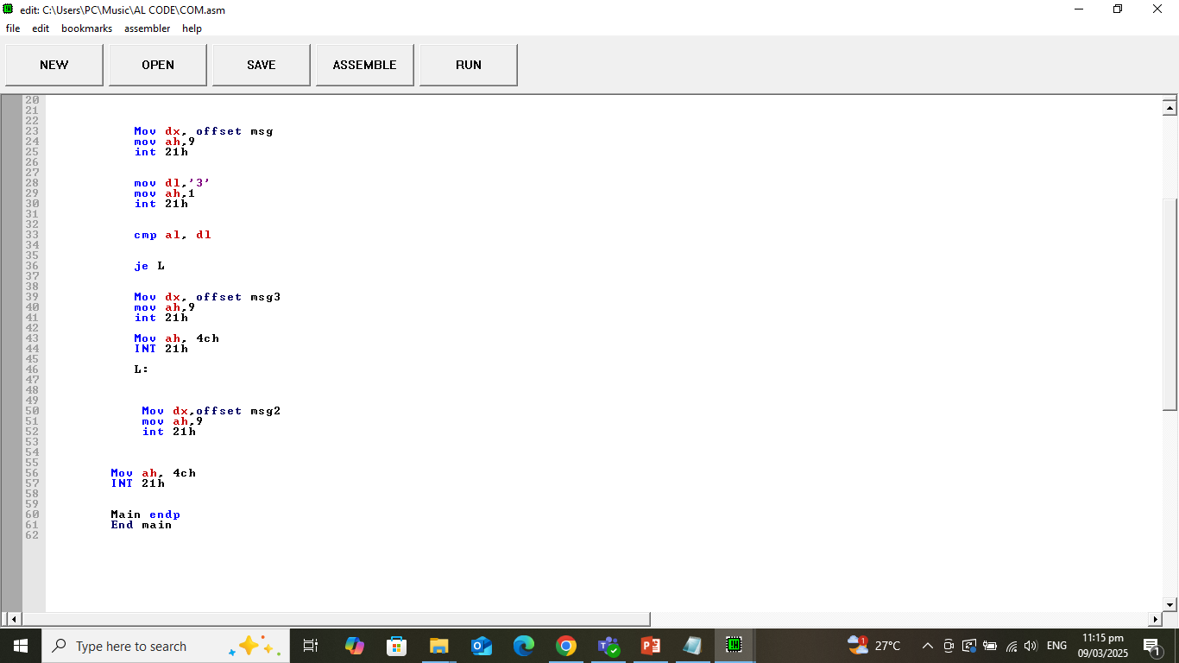

Slide 12
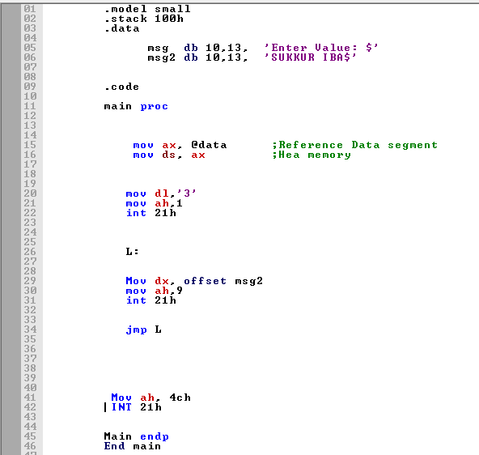

Slide 13
Example
Display the entire IBM character set
TITLE PGM6_1.ASM
.MODEL SMALL
.STACK 100H
.CODE
MAIN PROC
MOV AH,2 ; display char function.
MOV CX,256 ; no. of chars to display.
MOV DL,0 ;DL has the ASCII code of NULL char.
PRINT_LOOP:
INT 21h ;DISPLAY A CHAR.
INC DL ; INCREMENT ASCII CODE.
DEC CX ; DECREMENT COUNTER.
JNZ PRINT_LOOP ; KEEP GOING IF CX#0
; DOS exit
MOV AH,4CH
INT 21h
MAIN ENDP
END MAIN

Slide 14
Conditional jump instructions
If the flag settings match the instruction, control transfers to the target location
If the match fails, the CPU ignores the conditional jump and execution continues with the next instruction.

Slide 15
Conditional jump
In assembly language, when two numbers are compared, it is imperative to know that:
A signed number can be Greater, Less, or Equal to another signed number.
An unsigned number can be Above, Below, or Equal to another unsigned number.

